Slide 1
Robot Cognition
Team Toucan
Angela Tran: Team Leader
Tristan Lee: Communications Manager
Makya Geist-Delgado: Design Manager
Khaled Almathkour: Logistics Manager
Sponsor: Bill Michael
Faculty Sponsor: Leslie Tekamp
4-29-2022

Slide 2
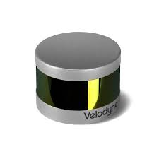
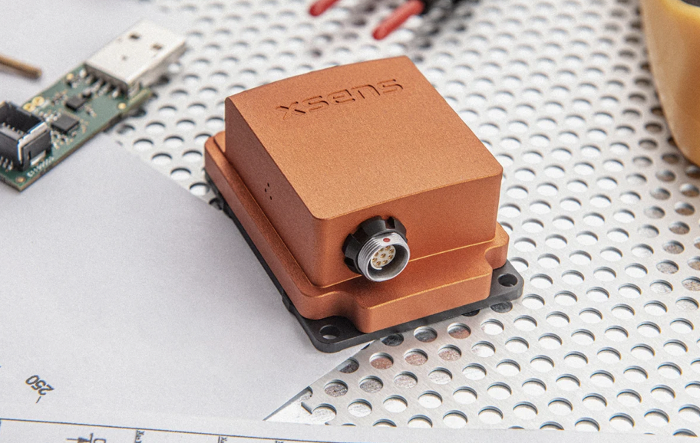
Problem Overview
Professor Bill Michael requested a sensor platform to be built that is capable of taking information from the surrounding area and processing for a cognition robot
Input information includes GPS position, 3D visual data, and attitude
Weighs 5kg or less
Can be powered by 6S through 12S LIPO (Lithium polymer) batteries
Formats collected data into a single processing system (Python on Jetson Nano)

Slide 3
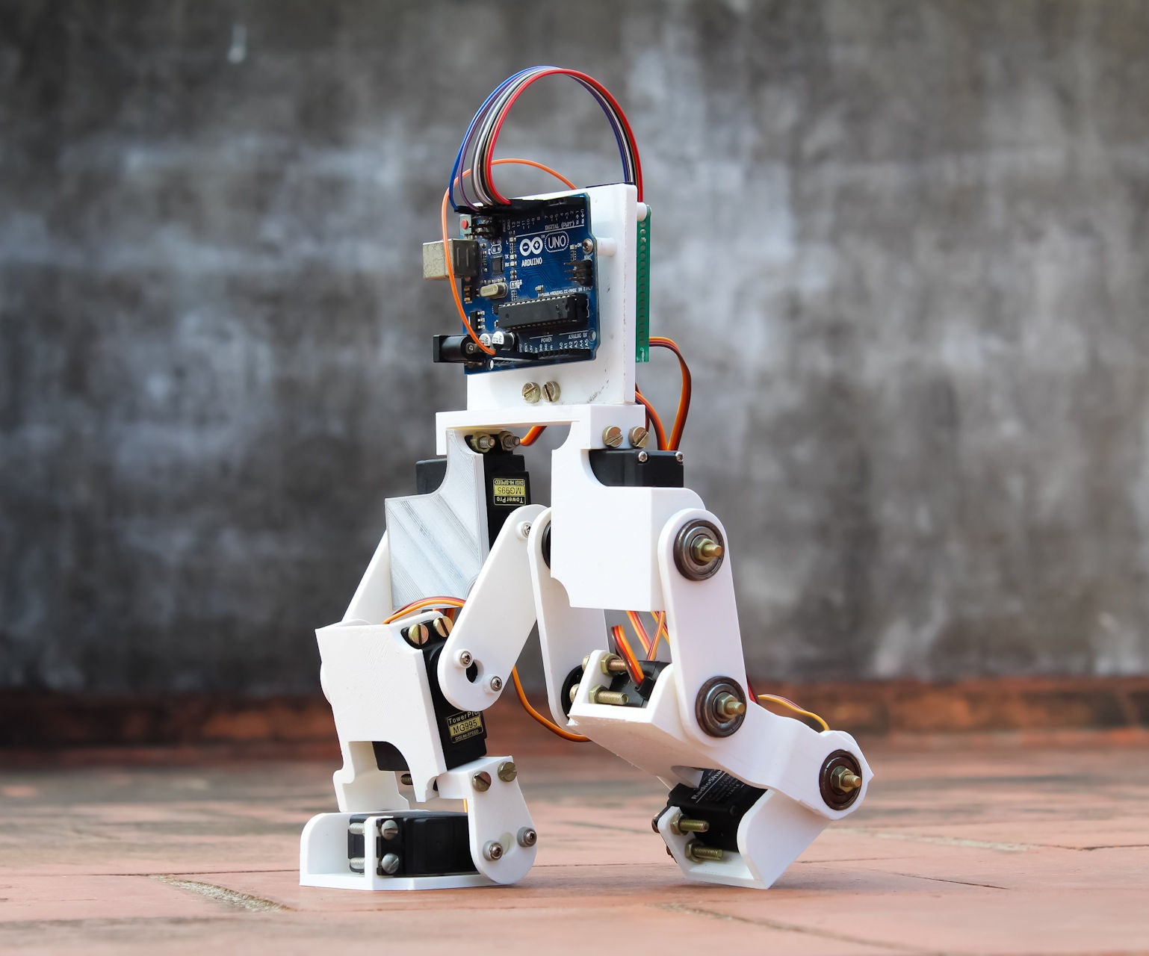
Problem background
Cognition: Learning from experience or user input
In this case, processing sensory input
Out of Scope Goals:
Creating a moving platform in addition to stationary platform to move around (on wheels or legs)

Slide 4
Customer Requirements
Requirement
Power Supply | 18-48V
Peripherals | GPS, IMU, LIDAR, Camera
Power Output | 5VDC at 10A
Power Output | 3.3VDC at 10A
Power Output | 12VDC at 5A
Generates | Point-cloud data, spatial and image data, location data
Collects | Accurate geo positioning, image and video collection, attitude and gyroscope data, inertial data

Slide 5
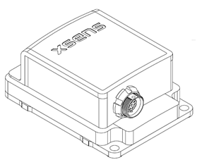
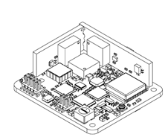
IMU (Inertial Measurement Unit)
Xsens MTI-10-2A8G4
Xsens MTI-OEM
Cased
Operating power: 100mW
Weighs 55 grams (cased)
Operating temperature: -40 to 85°C
USB communication protocol
Original Equipment Manufacturer (OEM)
Operating power: 100mW
Weighs 11 grams
Operating temperature: -40 to 85°C
USB and UART (universal asynchronous receiver/transmitter) communication protocols
Cased
OEM

Slide 6
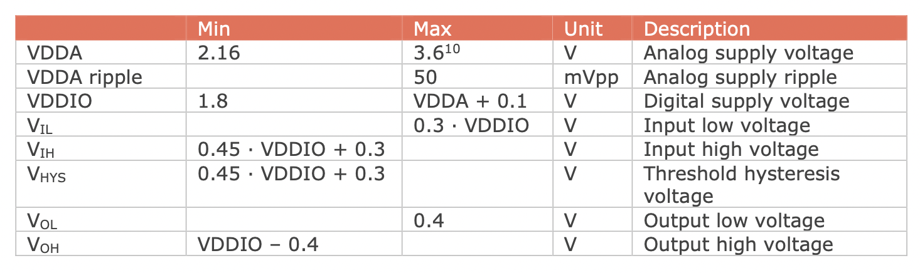
IMU Electrical Specifications

Slide 7
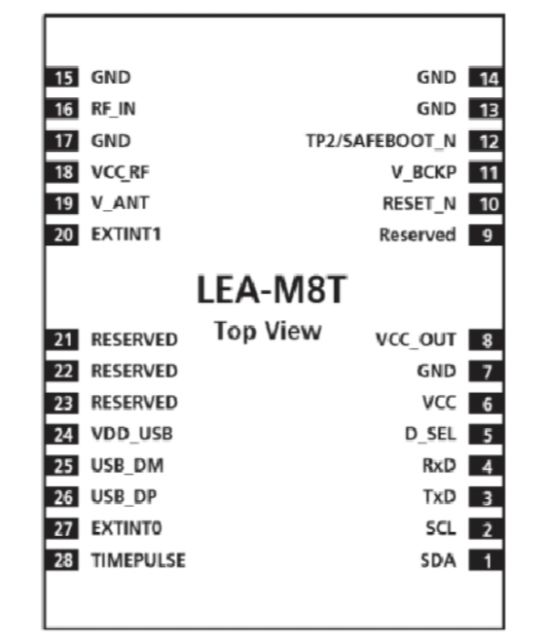
GPS (Global Positioning System)
Ublox LEA-M8T with WD22UGRC interface board
Operating power: 2.7V to 3.6V
Operating temperature: -40 to 85°C
SPI (serial peripheral interface), UART, and I2C (inter-integrated circuit) communication protocols

Slide 8
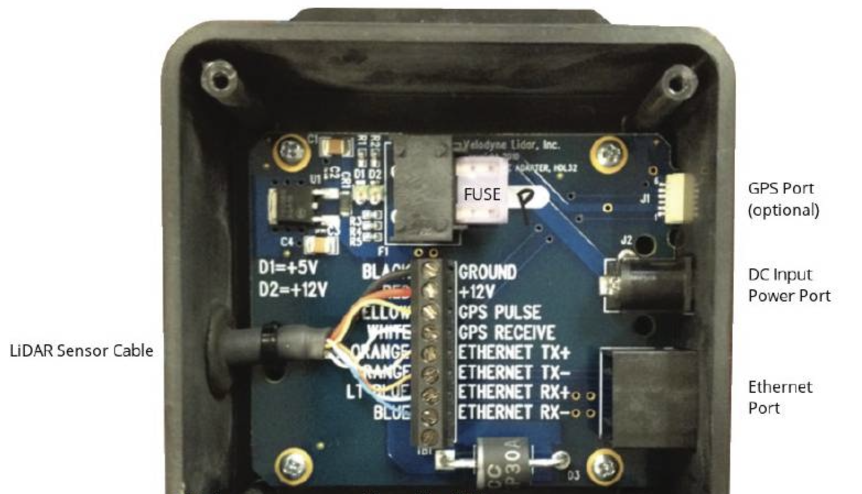
LIDAR (Light Detection and Ranging)
Velodyne LiDAR PUCK 16
Operating power: 3V-15V
Ethernet and UART communication protocols
Operating Temperatures: -10 to 60°C

Slide 9
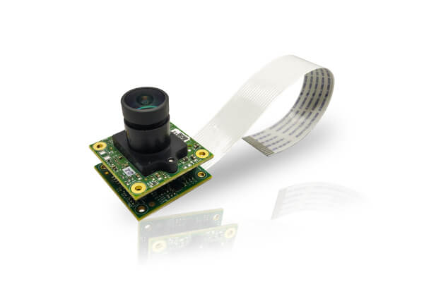
Camera Candidate: e-CAM24_CUNX
MIPI camera serial interface 2 (CSI-2) communication protocol
Resolution: 1920x1200 (Adjustable)
Operating temperatures: -30 to 70° C
Operating voltage: 3.3V

Slide 10
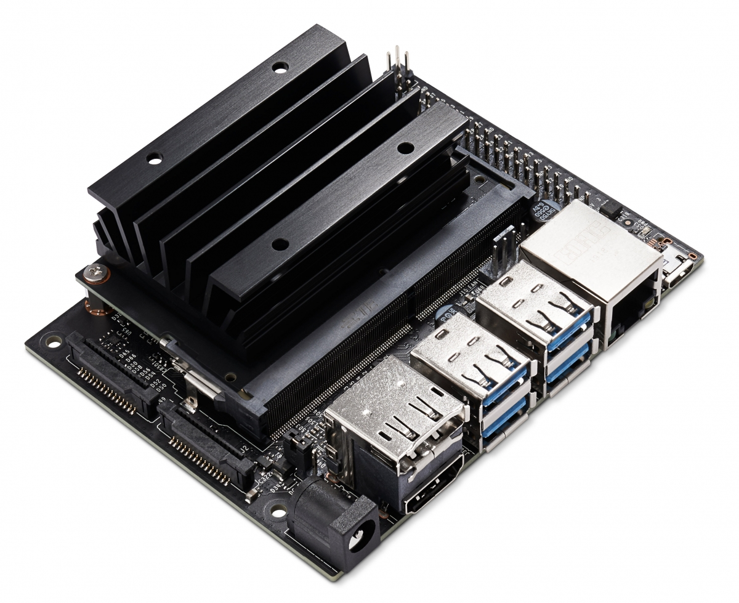
Processor Candidate: NVIDIA Jetson Nano
Relevant Ports
Name | I/O | Supported Devices | Speed
MIPI CSI 2 (x2) | Input | Camera | 1.5 Gbits/s
I2C (x3) | Bidirectional | 3.3V Devices | 100 Kbits/s - 1 Mbits/s
I2C | Bidirectional | 1.8V Devices | 100 Kbits/s - 1 Mbits/s
SPI | Bidirectional | 1.8V Devices | 45 Mbits/s - 65Mbits/s
Ethernet |  |  | 10 Mbits/s - 1Gbits/s
UART |  |  | 12.5 Mbits/s
USB 2.0 (x4) | Bidirectional |  | 480 Mbits/s
USB 3.0 | Input |  | 5Gbits/s

Slide 11
Required Ports:
Jetson Nano satisfies these requirements
Port | Sensor
MIPI CSI 2 | Camera
USB 2.0 | IMU (cased)
UART | IMU (OEM)
I2C (3.3V) | GPS
Ethernet | LIDAR

Slide 12
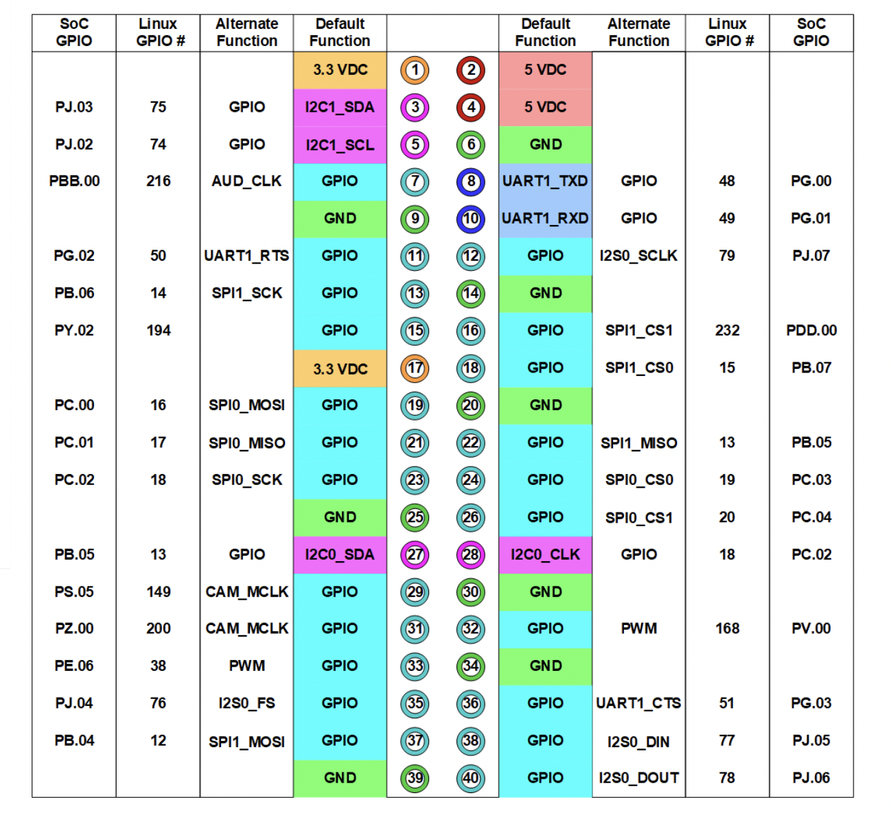
Jetson Nano Pinout (Relevant Pins)

Slide 13
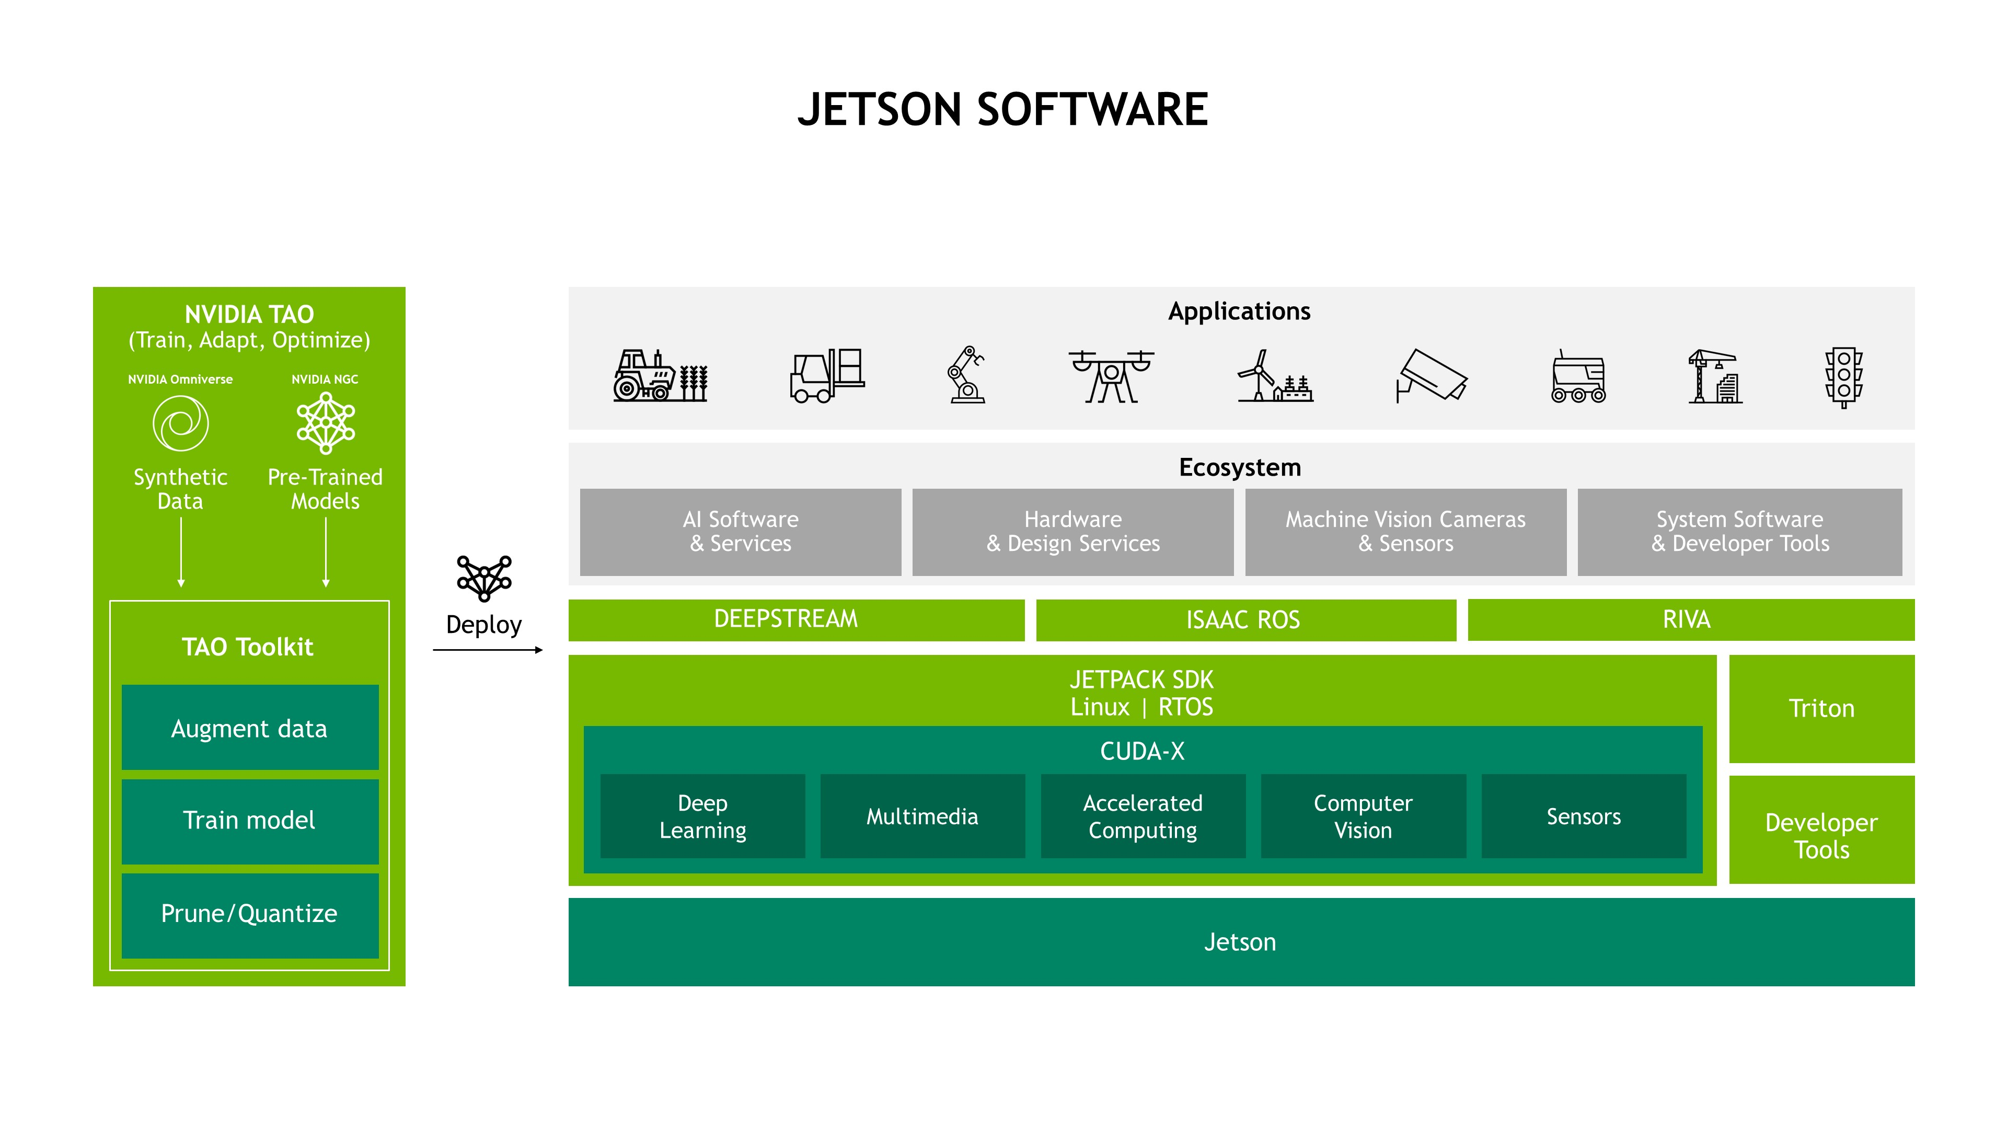
Jetson Nano Software
Jetson Nano is supported with the NVIDIA developer software stack

Slide 14
Relevant Standards
Standards
Protocol | Standard | Explanation
Ethernet | IEEE 802 | speeds of operation from 1 Mb/s to 400 Gb/s using a common media access control (MAC)
MIPI CSI-2 | MIPI A-PHY | Asymmetric data link layer with point-to-point or daisy-chain topology
Serial Peripheral Interface (SPI) | IEEE 1687 | Synchronous clock interface with the ability to access networks embedded in semiconductor devices
Inter integrated Circuit (I2C) | IEEE 1687 | Synchronous clock interface with the ability to access networks embedded in semiconductor devices

Slide 15
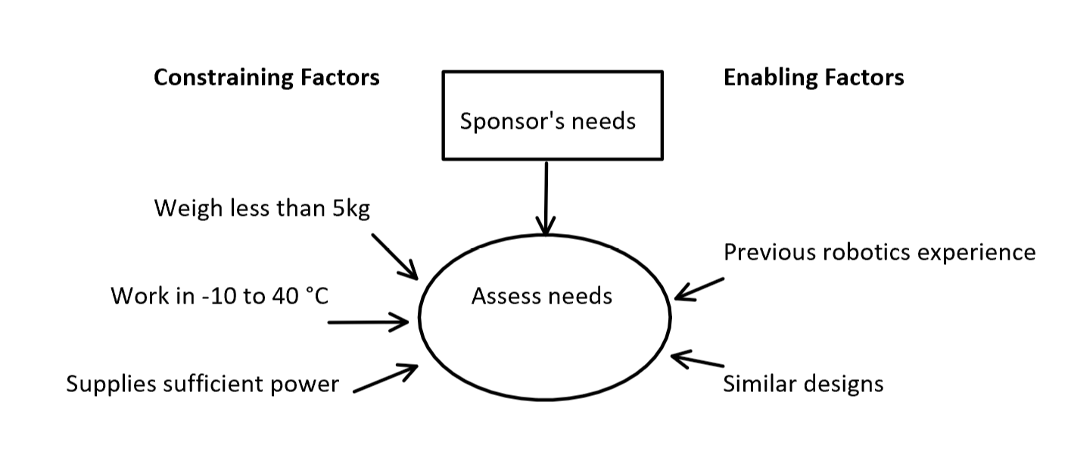
Constraints
Needs to weigh less than 5 kg
Function in temperatures from -10 °C to 40 °C
Supplying sufficient power

Slide 16
Requirements Analysis
The finished product must not weigh more than 5kg and maintain full functionality from -10°C to 40°C.
Capable of being powered by an 18-48VDC power source (6S - 12S LIPO battery)
The robot must be able to work in most if not all environments and conditions.
Want: Create a vessel to utilize the technology and move around autonomously

Slide 17
System Design Expectations
A robot cognition platform that operates autonomously is the design goal
Special impact will be in the robotics and firmware development experience
Most effort will be dedicated to software and hardware integration (getting all components to work together as desired
Anticipated problems come from the difficulty of integrating several peripherals onto a singular platform as well as optimized performance in every environment

Slide 18
Issues
Lack of familiarity with the software GUI and python programming language
Difficulty with integrating all peripherals
Can be solved with careful examination of datasheets and continued learning and practice with Python

Slide 19
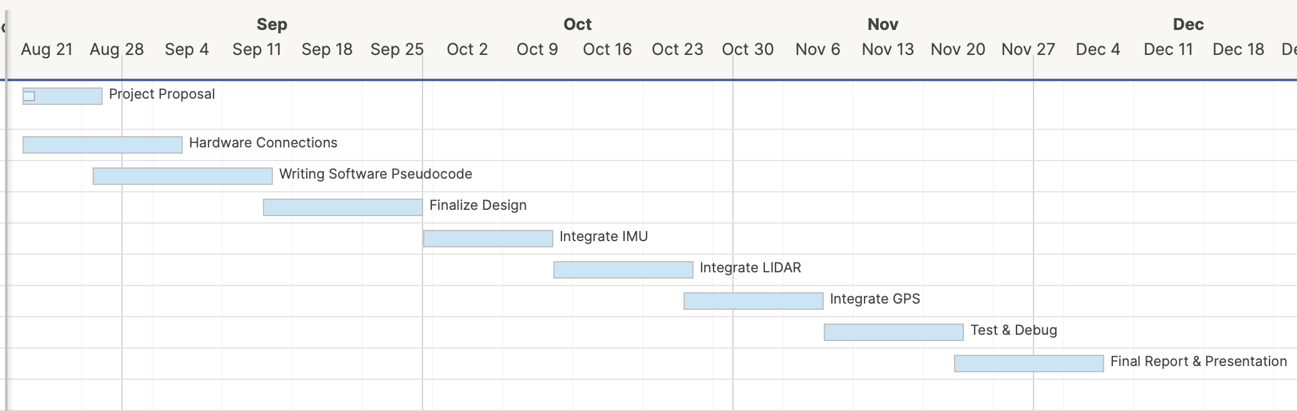
Timeline

Slide 20
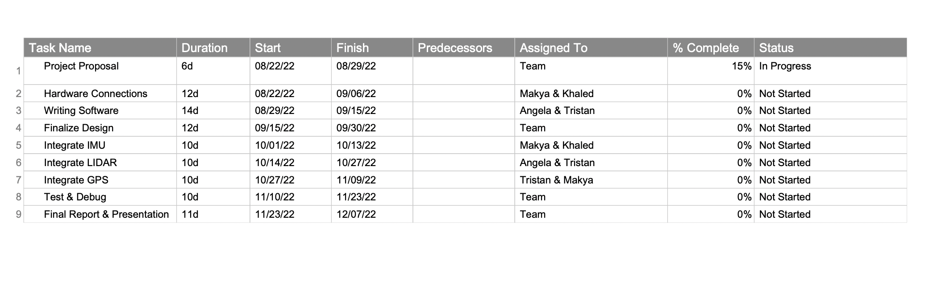
Timeline

Slide 21
Draft Budget
IMU XSens MTI-102A8G4: $449.00 (Provided)
Ublox LEA-M8T with WD22UGRC interface board:$89.00 (Provided)
LIDAR: Velodyne VLP-16: $4,500 (Provided)
NVIDIA Jetson Nano: $63.50
e-CAM24_CUNX: $149.00
Misc. Machine shop and 3D printed items ~$100
Misc. Tools ~$50

Slide 22
Societal Concerns
Ethical
Disclosure of personally identifiable information
Possible security risks
Sustainability
Use of rechargeable batteries
Produces little to no waste

Slide 23
Conclusion
Team objective is to design a robot cognition platform to take information from its surroundings from the IMU, GPS, and LIDAR sensors and process the information.
The platform will use the Jetson Nano Python programming interface
Questions?

